Slide 1

The Cute Corner Fashion & Design Institute

Slide 2
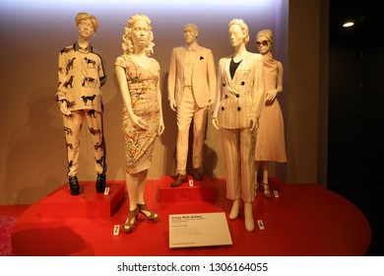
The Cute Corner Fashion & Design Institute
Agenda
  Goals
  Purpose
  The Future
  What I Need

Slide 3
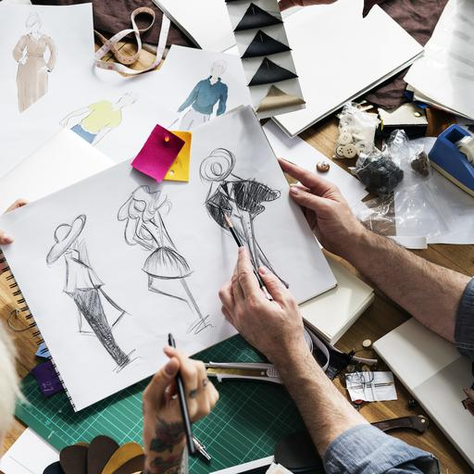
Goals
Develop an academic background that nurtures professional and intellectual development of students
Establish and maintain a dedication to academic activities in creativity and research by the use of technology
Provide quality certificate courses such as fashion design, textile design, fashion styling and image design, and fashion communication that give the required basics for the students’ career goals.

Slide 4
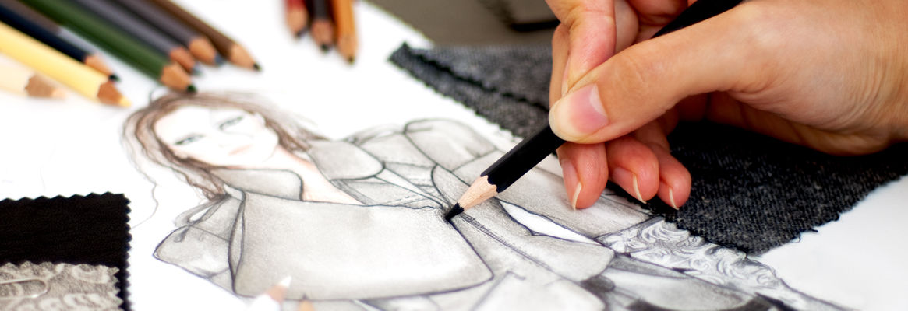
Purpose
Providing opportunities to students residing in Austin, Texas talented in fashion and design
Incorporating students from poor background by charging a considerable fee
Creating job opportunities for the Austin residents
Producing locally trained fashion designers
Building community identity

Slide 5

The future
This institute aims beyond offering fashion design courses
The institute aims at adding more courses including
  Leather design
  Fashion Design and Business management
  Jewellery Design
Additional specialization programs will include
  Fashion Journalism
  Theatre costume designing
  Fashion & Law

Slide 6

What we Need
An approximation of $100k funding for construction of the institute
Support in learning materials including sewing machines, fashion and Design textbooks, and fabrics
Bursaries/scholarships for needy students
Funding to hire 10 well qualified tutors and with at least one year experience in a fashion and design institute/school

